Slide 1
SECURE HASH ALGORITHM
A SEARIES OF SHA…

Slide 2
Secure Hash Algorithm
SHA originally designed by NIST & NSA in 1993
was revised in 1995 as SHA-1
US standard for use with DSA signature scheme
  standard is FIPS 180-1 1995, also Internet RFC3174
  nb. the algorithm is SHA, the standard is SHS
based on design of MD5 with key differences
produces 160-bit hash values
recent 2005 results on security of SHA-1 have raised concerns on its use in future applications
Notes:
The Secure Hash Algorithm (SHA) was developed by the National Institute of Standards and Technology (NIST) and published as a federal information processing standard (FIPS 180) in 1993; a revised version was issued as FIPS 180-1 in 1995 and is generally referred to as SHA-1. The actual standards document is entitled Secure Hash Standard. SHA is based on the hash function MD4 and its design closely models MD4. SHA-1 produces a hash value of 160 bits. In 2005, a research team described an attack in which two separate messages could be found that deliver the same SHA-1 hash using 2^69 operations, far fewer than the 2^80 operations previously thought needed to find a collision with an SHA-1 hash [WANG05]. This result should hasten the transition to newer, longer versions of SHA.

Slide 3
How SHA Works?
Digest Length=160 bit
I/P Text=512 bit
Sub Block size=32bit
512/32=16 total Sub blocks
No. Of Rounds=4
Iteration per round=20
Chaining Variable = 5*32=160
K[t] constant= Where t=0 to 79
O/P-> four 32 bit blocks

Slide 4
SHA Overview
Padding: Length of the message is 64 bits short of multiple of 512 after padding.
Append a 64-bit length value of original message is taken.
Divide the input into 512-bit blocks
Initialise CV 5-word (160-bit) buffer (A,B,C,D,E) to
  (A=01 23 45 67,
  B=89 AB CD EF,
  C=FE DC BA 98,
  D=76 54 32 10,
  E=C3 D2 E1 F0)
Notes:
Note that the SHA-1 Overview is very similar to that of MD5.

Slide 5
Continue…
Process Blocks now the actual algorithm begins. message in 16-word (512-bit) chunks:
  Copy CV into single register for storing temporary intermediate as well as the final results.
  Divide the current 512-bit blocks into 16 sub-blocks, each consisting of 32 bits.
  Has No. Of Rounds=4, each round consisting of 20 bit /step iteration operations on message block & buffer
  expand 16 words into 80 words(20*4) by mixing & shifting.K[t] constant= Where t=0 to 79
  Form new buffer value by adding output to input.
6. output hash value is the final buffer value

Slide 6
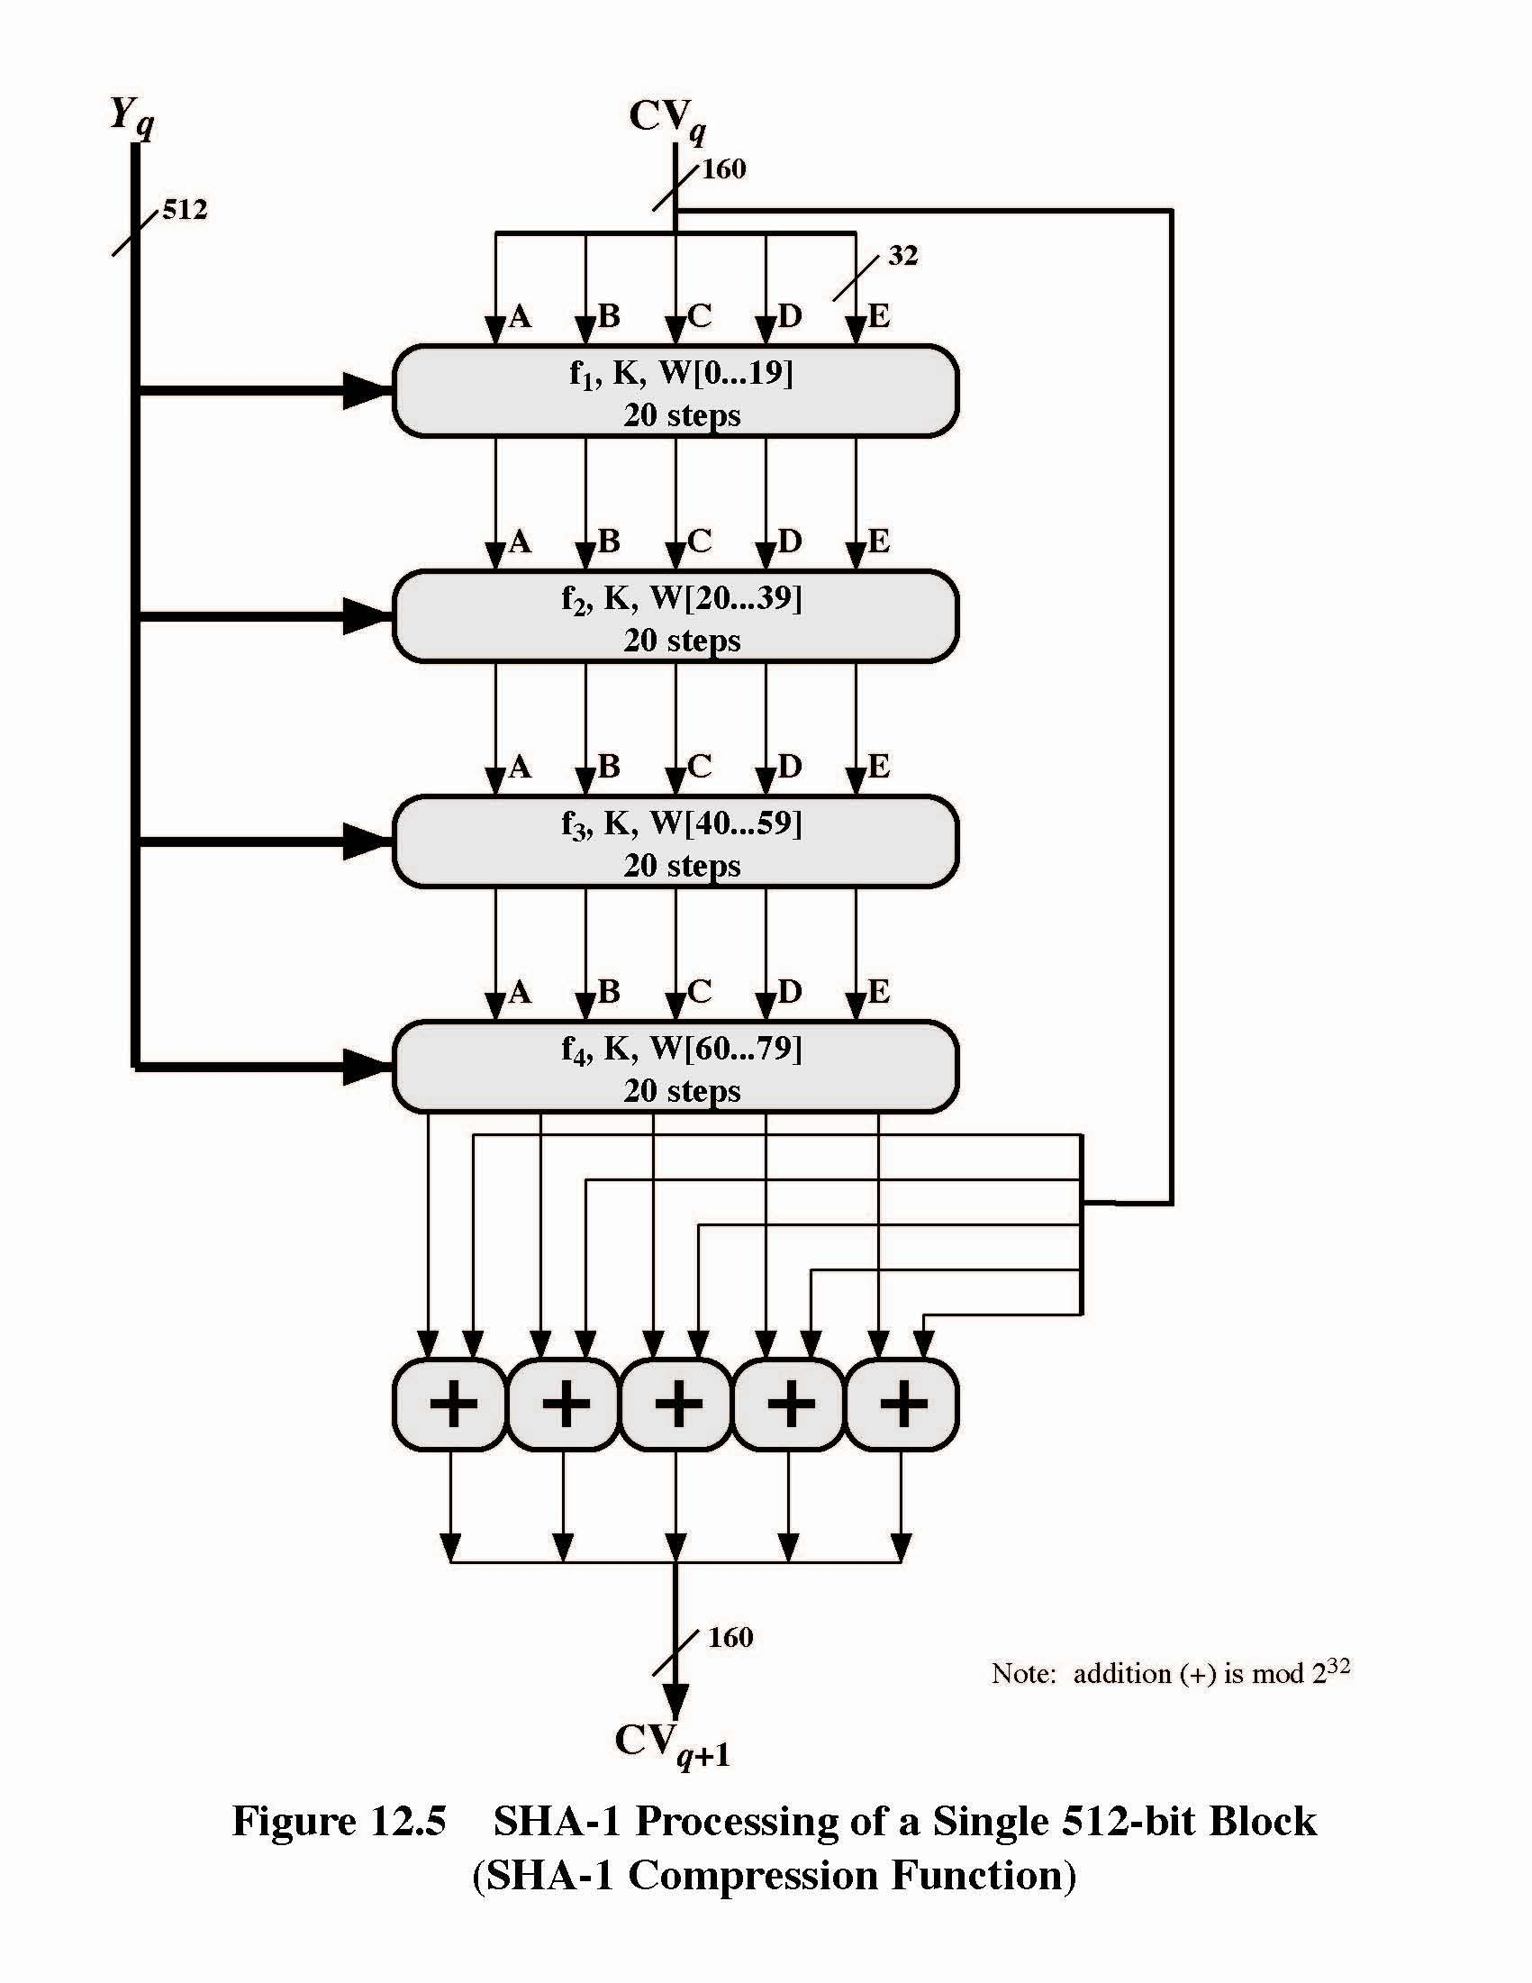

Slide 7
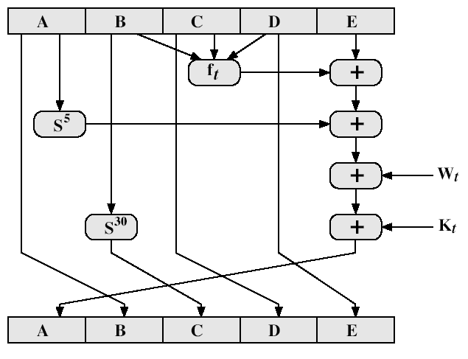
SHA-1 Compression Function
ABCDE=(F[t]+E+S5(A)+W[t]+K[t]),>>>Shift right by 1 bit for next iteration
Notes:
Stallings Fig 12-6.

Slide 8
SHA-1 Compression Function terms
each round has 20 steps which replaces the 5 buffer words thus:
  (A,B,C,D,E) <-(E+f(t,B,C,D)+(A<<5)+W_{t}+K_{t}),A,(B<<30),C,D)
ABCDE refer to the 5 words of the buffer
t is the step number
f(t,B,C,D) is nonlinear function for round
W_{t} is derived from the message block
K_{t} is a constant value
S^t circular left shift of 32 bit sub-block by t bits
Notes:
Can see SHA shares much in common with MD4/5, but with 20 instead of 16 steps in each of the 4 rounds. Note the 4 constants are based on sqrt(2,3,5,10). Note also that instead of just splitting the input block into 32-bit words and using them directly, SHA-1 shuffles and mixes them using rotates & XOR’s to form a more complex input, and greatly increases the difficulty of finding collisions.

Slide 9
Process F(t) in each SHA-1 round
where g can be expressed as:
ROUND 1: (b AND c) OR ((NOT b) AND (d)) same as MD5
ROUND 2: b XOR c XOR d
ROUND 3: (b AND c) OR (b AND d) OR (c AND d)
ROUND 4: b XOR c XOR d

Slide 10
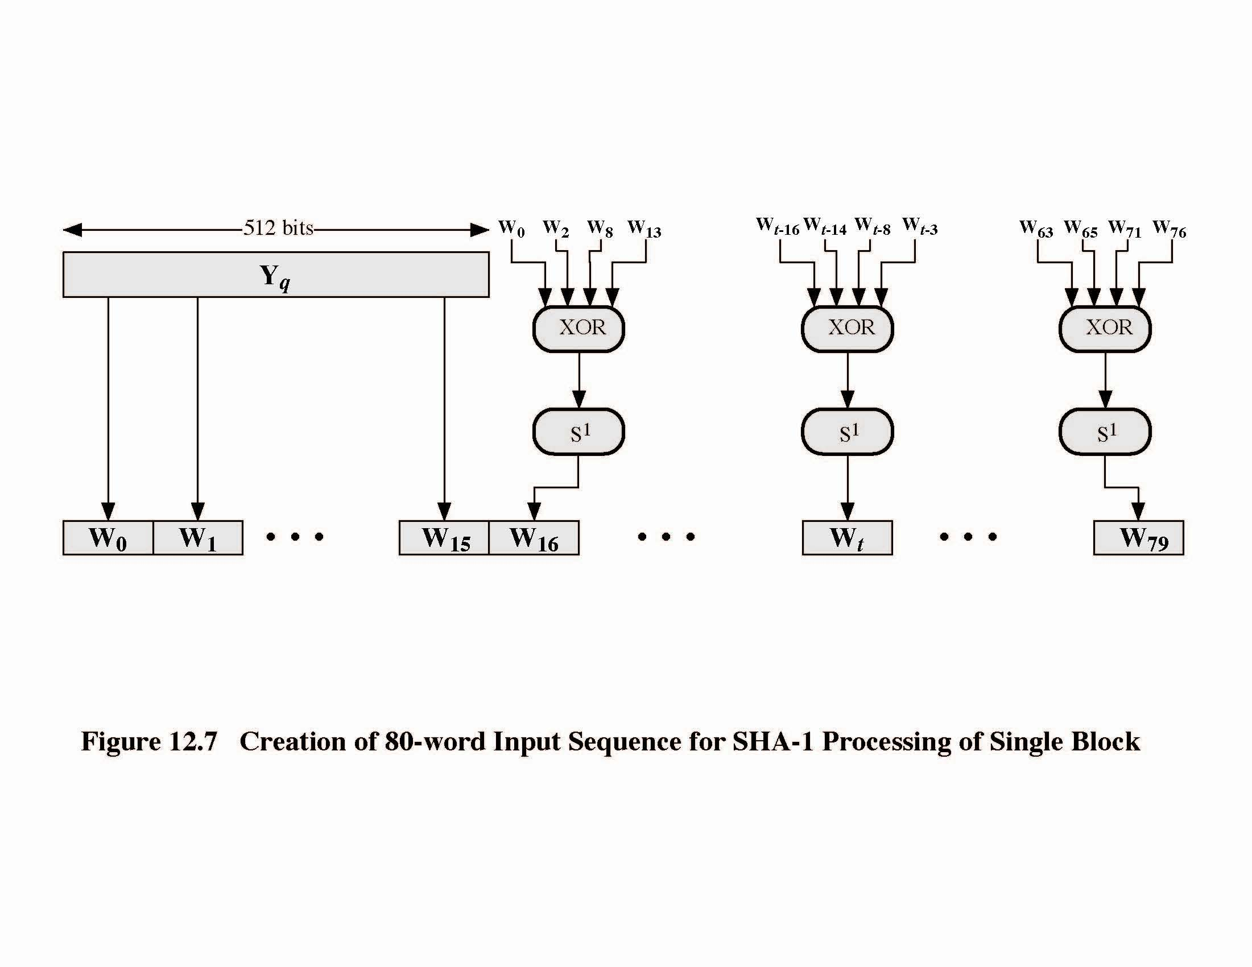
Creation of 80-word input W_{t}
Adds redundancy and interdependence among message blocks

Slide 11
SHA-1 verses MD5
brute force attack is harder (160 vs 128 bits for MD5)
not vulnerable to any known attacks (compared to MD4/5)
a little slower than MD5 (80 vs 64 steps)
both designed as simple and compact
optimised for big endian CPU's (SUN) vs MD5 for little endian CPU’s (PC)
Notes:
Compare using the design goals listed earlier.
SHA-1 is probably the preferred hash function for new applications. Currently no problems are known with it.

Slide 12
Revised Secure Hash Standard
NIST issued revision FIPS 180-2 in 2002
adds 3 additional versions of SHA
  SHA-256, SHA-384, SHA-512
  Different lengths of Message Digest in bits
designed for compatibility with increased security provided by the AES cipher
structure & detail is similar to SHA-1
hence analysis should be similar
but security levels are rather higher
Notes:
In 2002, NIST produced a revised version of the standard, FIPS 180-2, that defined three new versions of SHA, with hash value lengths of 256, 384, and 512 bits, known as SHA-256, SHA-384, and SHA-512. These new versions have the same underlying structure and use the same types of modular arithmetic and logical binary operations as SHA-1, hence analyses should be similar. In 2005, NIST announced the intention to phase out approval of SHA-1 and move to a reliance on the other SHA versions by 2010. See Stallings Table12.1 for comparative details of these algorithms.

Slide 13
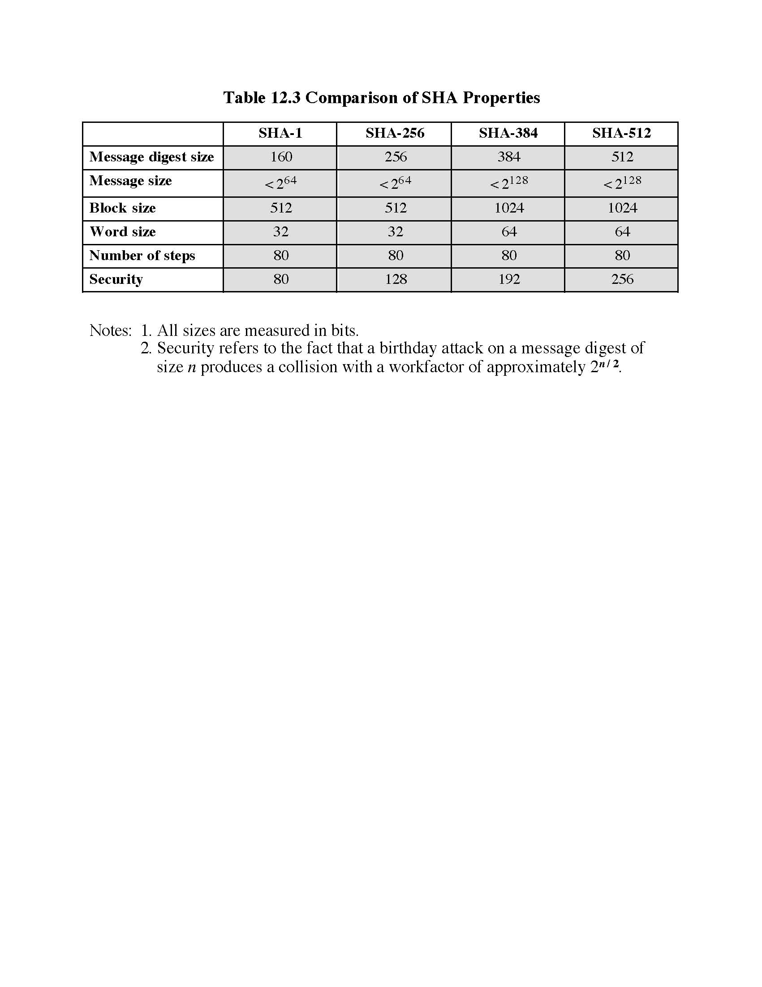

Slide 14
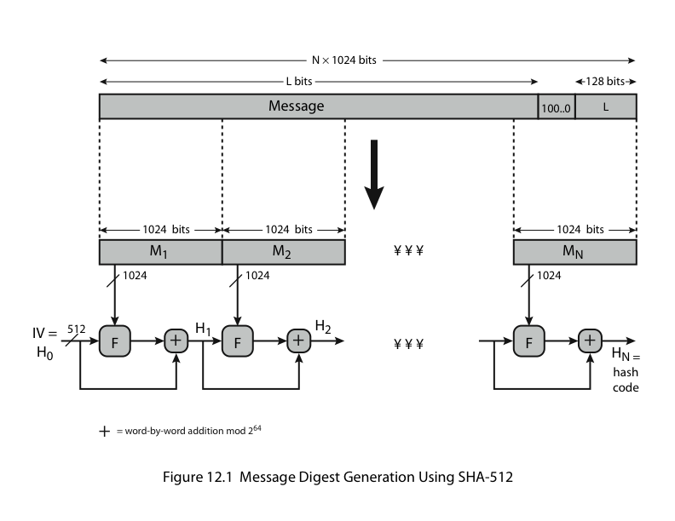
1. Padding,2.Append Length,3.Divide the input into 1024- bit blocks
Notes:
Now examine the structure of SHA-512, noting that the other versions are quite similar.
SHA-512 follows the structure depicted in Stallings Figure 12.1. The processing consists of the following steps:
• Step 1: Append padding bits
• Step 2: Append length
• Step 3: Initialize hash buffer
• Step 4: Process the message in 1024-bit (128-word) blocks, which forms the heart of the algorithm
• Step 5: Output the final state value as the resulting hash
See text for details.

Slide 15
4.Initialization Of Chaining Variable
8*64= 512 bits
A,B,C,D,E,F,G,H

Slide 16
5.Process Blocks
heart of the algorithm
processing message in 1024-bit blocks
consists of 80 rounds
  updating a 512-bit buffer TEMP CHAINING VARIABLES.
  using a 64-bit value Wt derived from the current message block
  and a round constant based on cube root of first 80 prime numbers
Notes:
The SHA-512 Compression Function is the heart of the algorithm. In this Step 4, it processes the message in 1024-bit (128-word) blocks, using a module that consists of 80 rounds, labeled F in Stallings Figure 12, as shown in Figure 12.2. Each round takes as input the 512-bit buffer value, and updates the contents of the buffer. Each round t makes use of a 64-bit value Wt derived using a message schedule from the current 1024-bit block being processed. Each round also makes use of an additive constant Kt, based on the fractional parts of the cube roots of the first eighty prime numbers. The output of the eightieth round is added to the input to the first round to produce the final hash value for this message block, which forms the input to the next iteration of this compression function, as shown on the previous slide.

Slide 17
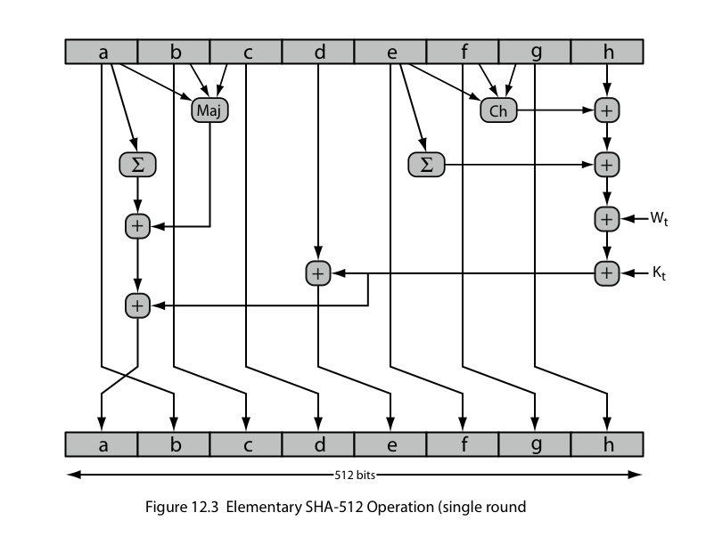
SHA-512 Round Function
Notes:
The structure of each of the 80 rounds is shown in Stallings Figure 12.3. Each 64-bit word shuffled along one place, and in some cases manipulated using a series of simple logical functions (ANDs, NOTs, ORs, XORs, ROTates), in order to provide the avalanche & completeness properties of the hash function. The elements are:
Ch(e,f,g) = (e AND f) XOR (NOT e AND g)
Maj(a,b,c) = (a AND b) XOR (a AND c) XOR (b AND c)
∑(a) = ROTR(a,28) XOR ROTR(a,34) XOR ROTR(a,39)
∑(e) = ROTR(e,14) XOR ROTR(e,18) XOR ROTR(e,41)
+ = addition modulo 2^64
Kt = a 64-bit additive constant
Wt = a 64-bit word derived from the current 512-bit input block.

Slide 18
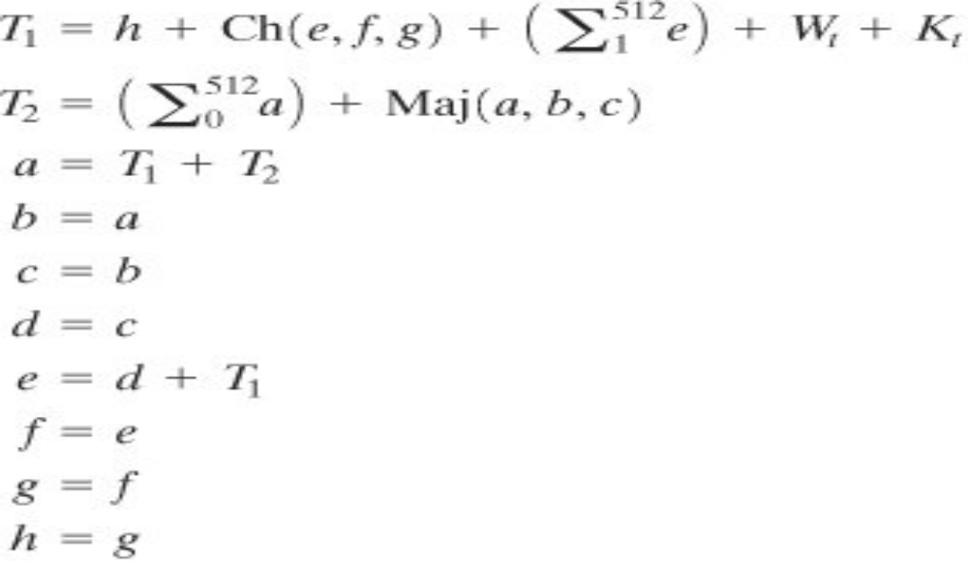
SHA-512 Round Function
Let us look in more detail at the logic in each of the 80 steps of the processing of one 512-bit block (Figure). Each round is defined by the following set of equations:

Slide 19
SHA-512 Round Function
where
t =step/round number; 0 t 79
Ch(e, f, g)= (e AND f) XOR (NOT e AND g)
the conditional function: If e then f else g
Maj(a, b,c)= (a AND b) XOR (a AND c) XOR (b AND c)
the function is true only of the majority (two or three) of the arguments are true.
Sum (ai)= RORT (ai By 28 Bit) XOR RORT (ai By 34 Bit) XOR
RORT (ai By 39 Bit)
Sum (ei)= RORT (ei By 14 Bit) XOR RORT (ei By 18 Bit) XOR
RORT (ei By 41 Bit)
ROTRn(x) = circular right shift (rotation) of the 64-bit argument x by n bits
Wt = a 64-bit word derived from the current 512-bit input block (i.e:- Message Digest)
Kt = a 64-bit additive constant
+ = addition modulo 2^64

Slide 20
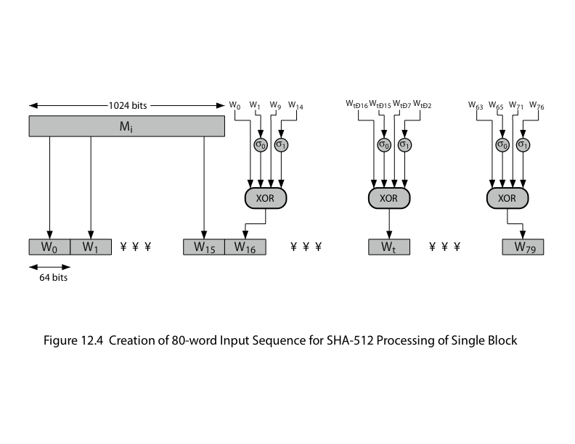
SHA-512 Round Function
Notes:
Stallings Figure 12.4 details how the 64-bit word values Wt are derived from the 1024-bit message. The first 16 values of Wt are taken directly from the 16 words of the current block. The remaining values are defined as a function of the earlier values using ROTates, SHIFTs and XORs as shown. The function elements are:
∂0(x) = ROTR(x,1) XOR ROTR(x,8) XOR SHR(x,7)
∂1(x) = ROTR(x,19) XOR ROTR(x,61) XOR SHR(x,6).

